Slide 1

Team 3 talabaktula srinivasa rao mallangi supriya komal gajbhiv Lakshmi teja yelisetty sai deepthi Junaid m
INVENTORY ANALYSIS REPORT
MENTOR : MAHENDRA SINGH

Slide 2
AGENDA
INTRODUCTION
KPI 1
KPI 2
KPI 3
KPI 4
KPI 5
KPI 6
KPI 7
KPI 8
KPI 9
KPI 10
DASHBOARD
CONCLUSION

Slide 3
INTRODUCTION
Today, we are delighted to present our Inventory Analysis Project Report, where we look into the core of inventory management and its pivotal role in our business success. In a dynamic and competitive market, understanding and optimizing our inventory is key to enhancing operational efficiency and maximizing profitability.
In the next few slides, we will navigate through essential Key Performance Indicators (KPIs) that shed light on various facets of our inventory. These KPIs have been carefully chosen to provide a comprehensive view of our sales performance, product-wise trends, and inventory dynamics.
Effective inventory management is not just about counting products on shelves; it's a strategic initiative that can significantly impact our bottom line. As we explore the Total Sales Analysis, Product Wise Sales, and Sales Growth, we aim to uncover patterns, identify opportunities, and address challenges that will enable us to make informed decisions.
Our ultimate goal is to provide actionable insights that guide strategic decision-making and propel us towards an even more successful and sustainable future.

Slide 4
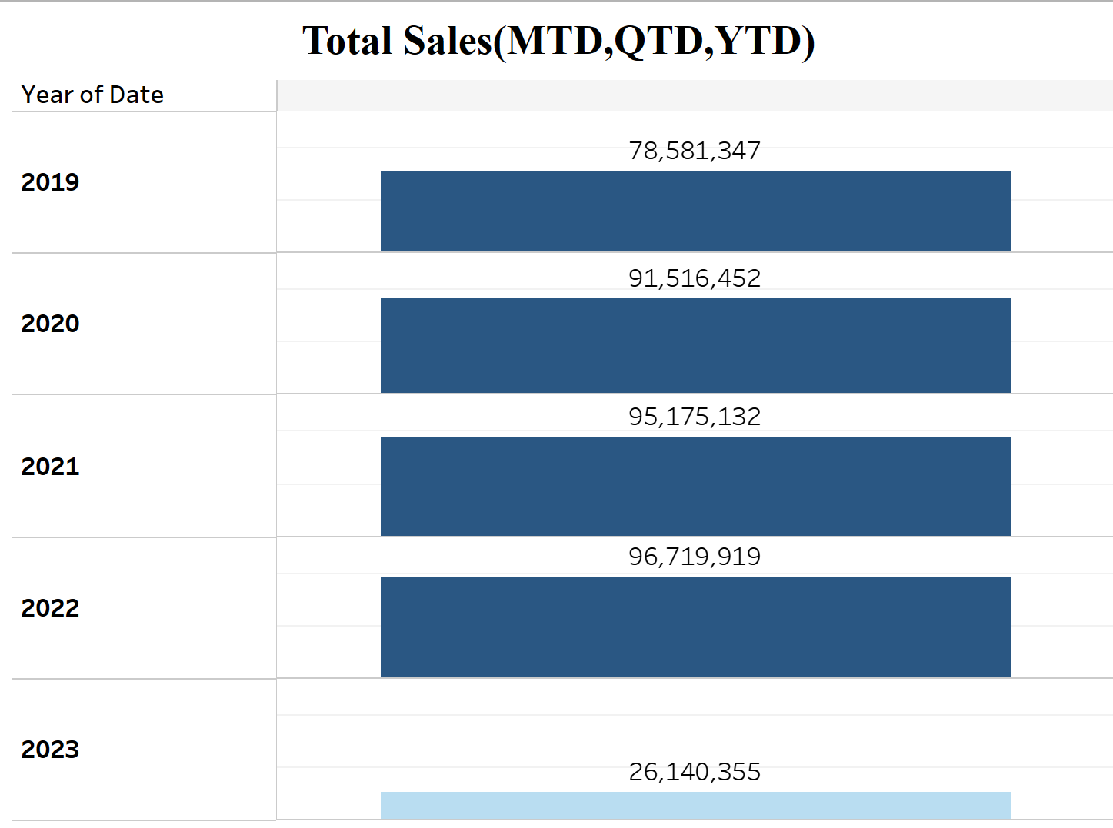
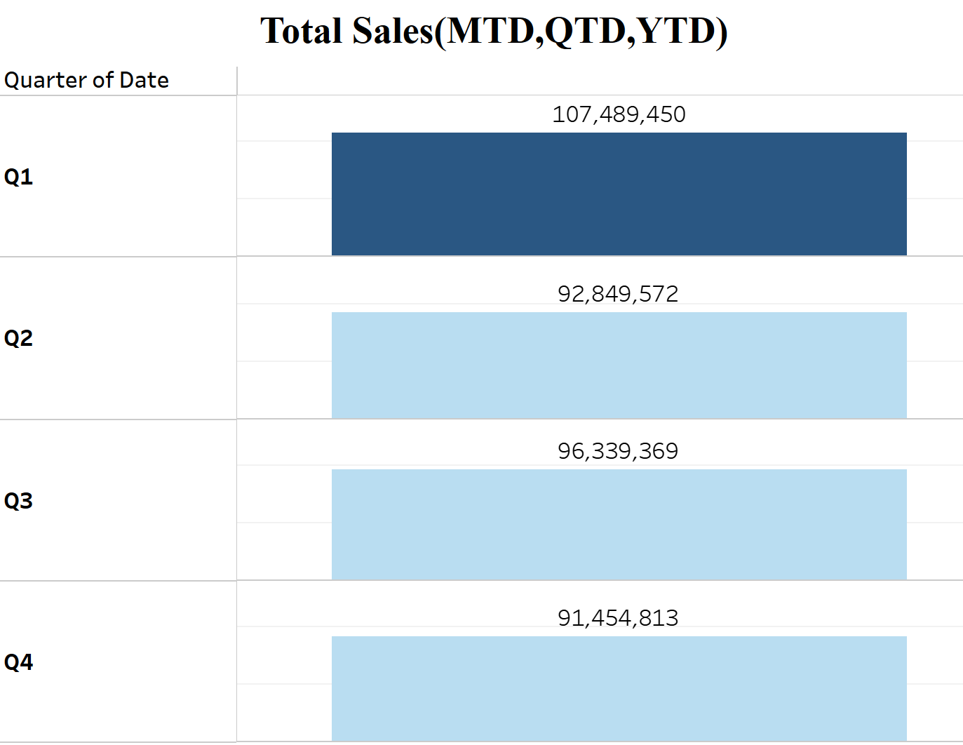
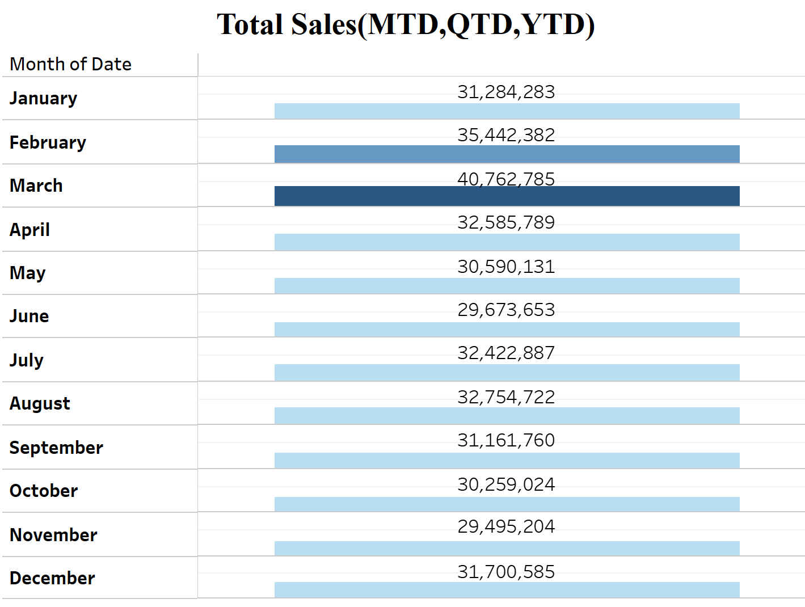
TOTAL SALeS BY YTD,QTD,MTD
The Chart shows the Year wise, Quarter wise and Month wise Total Sales. The Year wise Total Sales shows that in 2022 the total sales are more with 95,719,919 compare to other years.
The Quarter wise total Sales shows that sales are higher in Quarter 1 with 107,489,450 and lower in Quarter 4 with 91,454,813.
The Month Wise Sales shows that the month of march has higher sales with 40,762,785 and the month of November has less sales with 29,495,204.

Slide 5
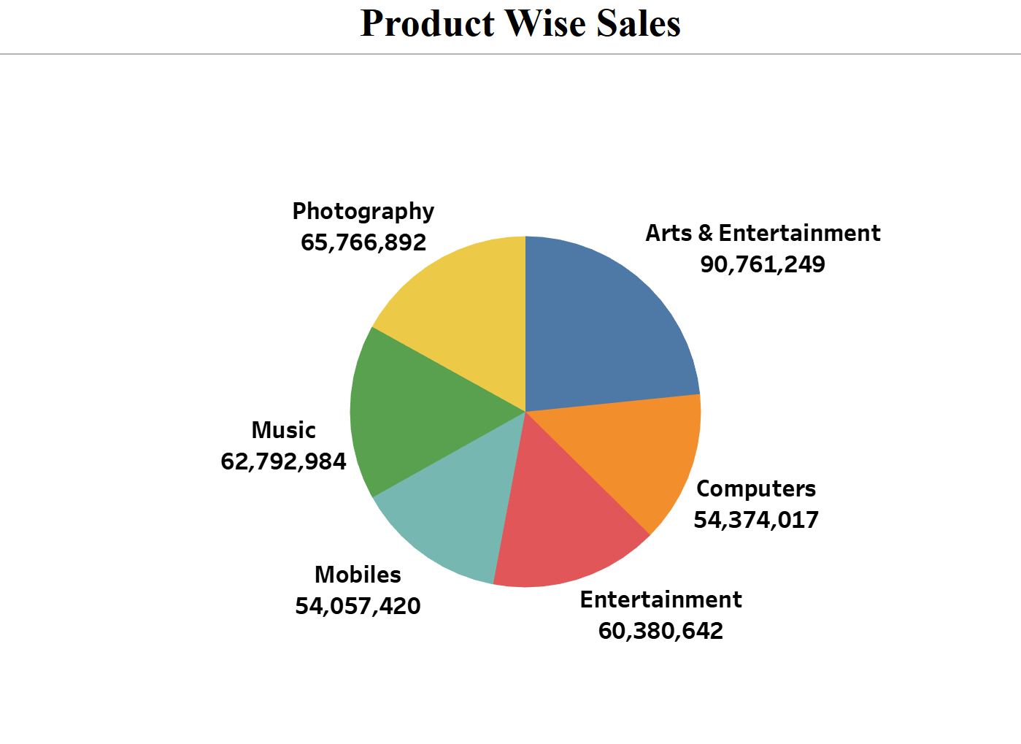
PRODUCT WISe SALeS
The Pie Chart Represents Product Wise Sales.
It Shows That Arts And Entertainment Have Higher Sales With 90,761,249 Which Means More Customers Are Showing Interest In Buying Arts And Entertainment Products.
The mobiles have less sales with 54,057,420. company has to focus on mobiles to increase the sales of mobiles.

Slide 6
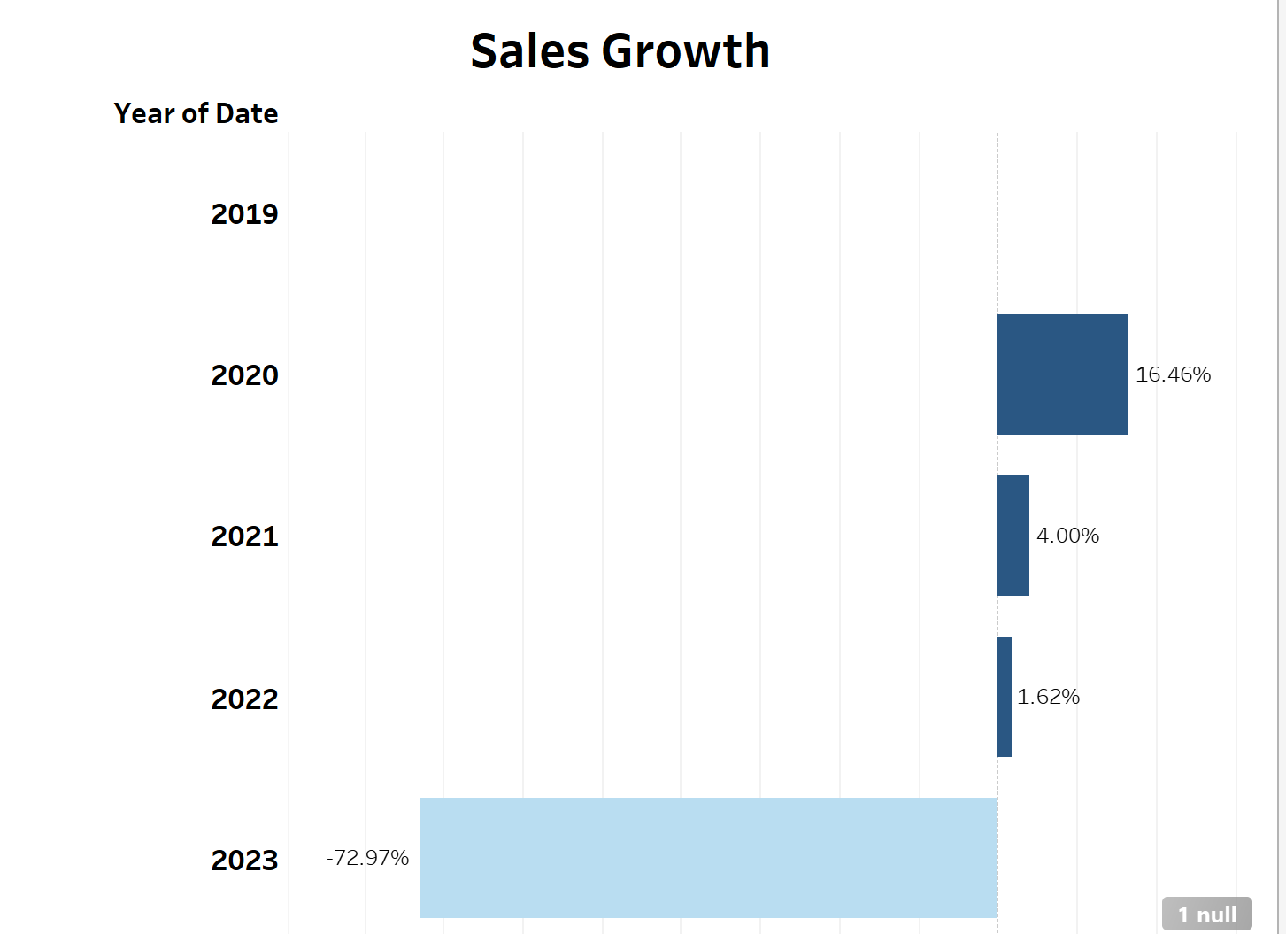
SALeS GROWTH
The chart represent sales growth according to year. In 2020 the growth of sales is more with 16.46% .
The growth of sales in 2023 is less with
-72.97%.
The sales growth is decreasing year by year so some measures has to be taken.

Slide 7
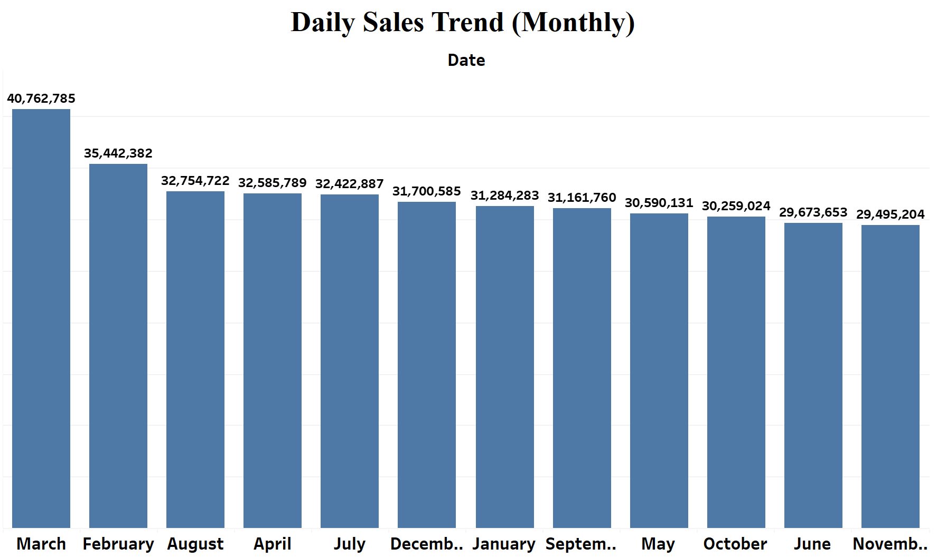
DAILY SALeS TReND
The Bar chart Represents The Daily Sales Trend. We Calculated The Month Wise Sales Amount.
We Can Observe That In The Month Of March The Amount Of Sales Are More And In The Month Of November The Amount Of Sales Are Lesser.
From This We Can Understand That The More Sales Are Happening In Month Of March And Less Sales Are Happening In Month Of November.

Slide 8
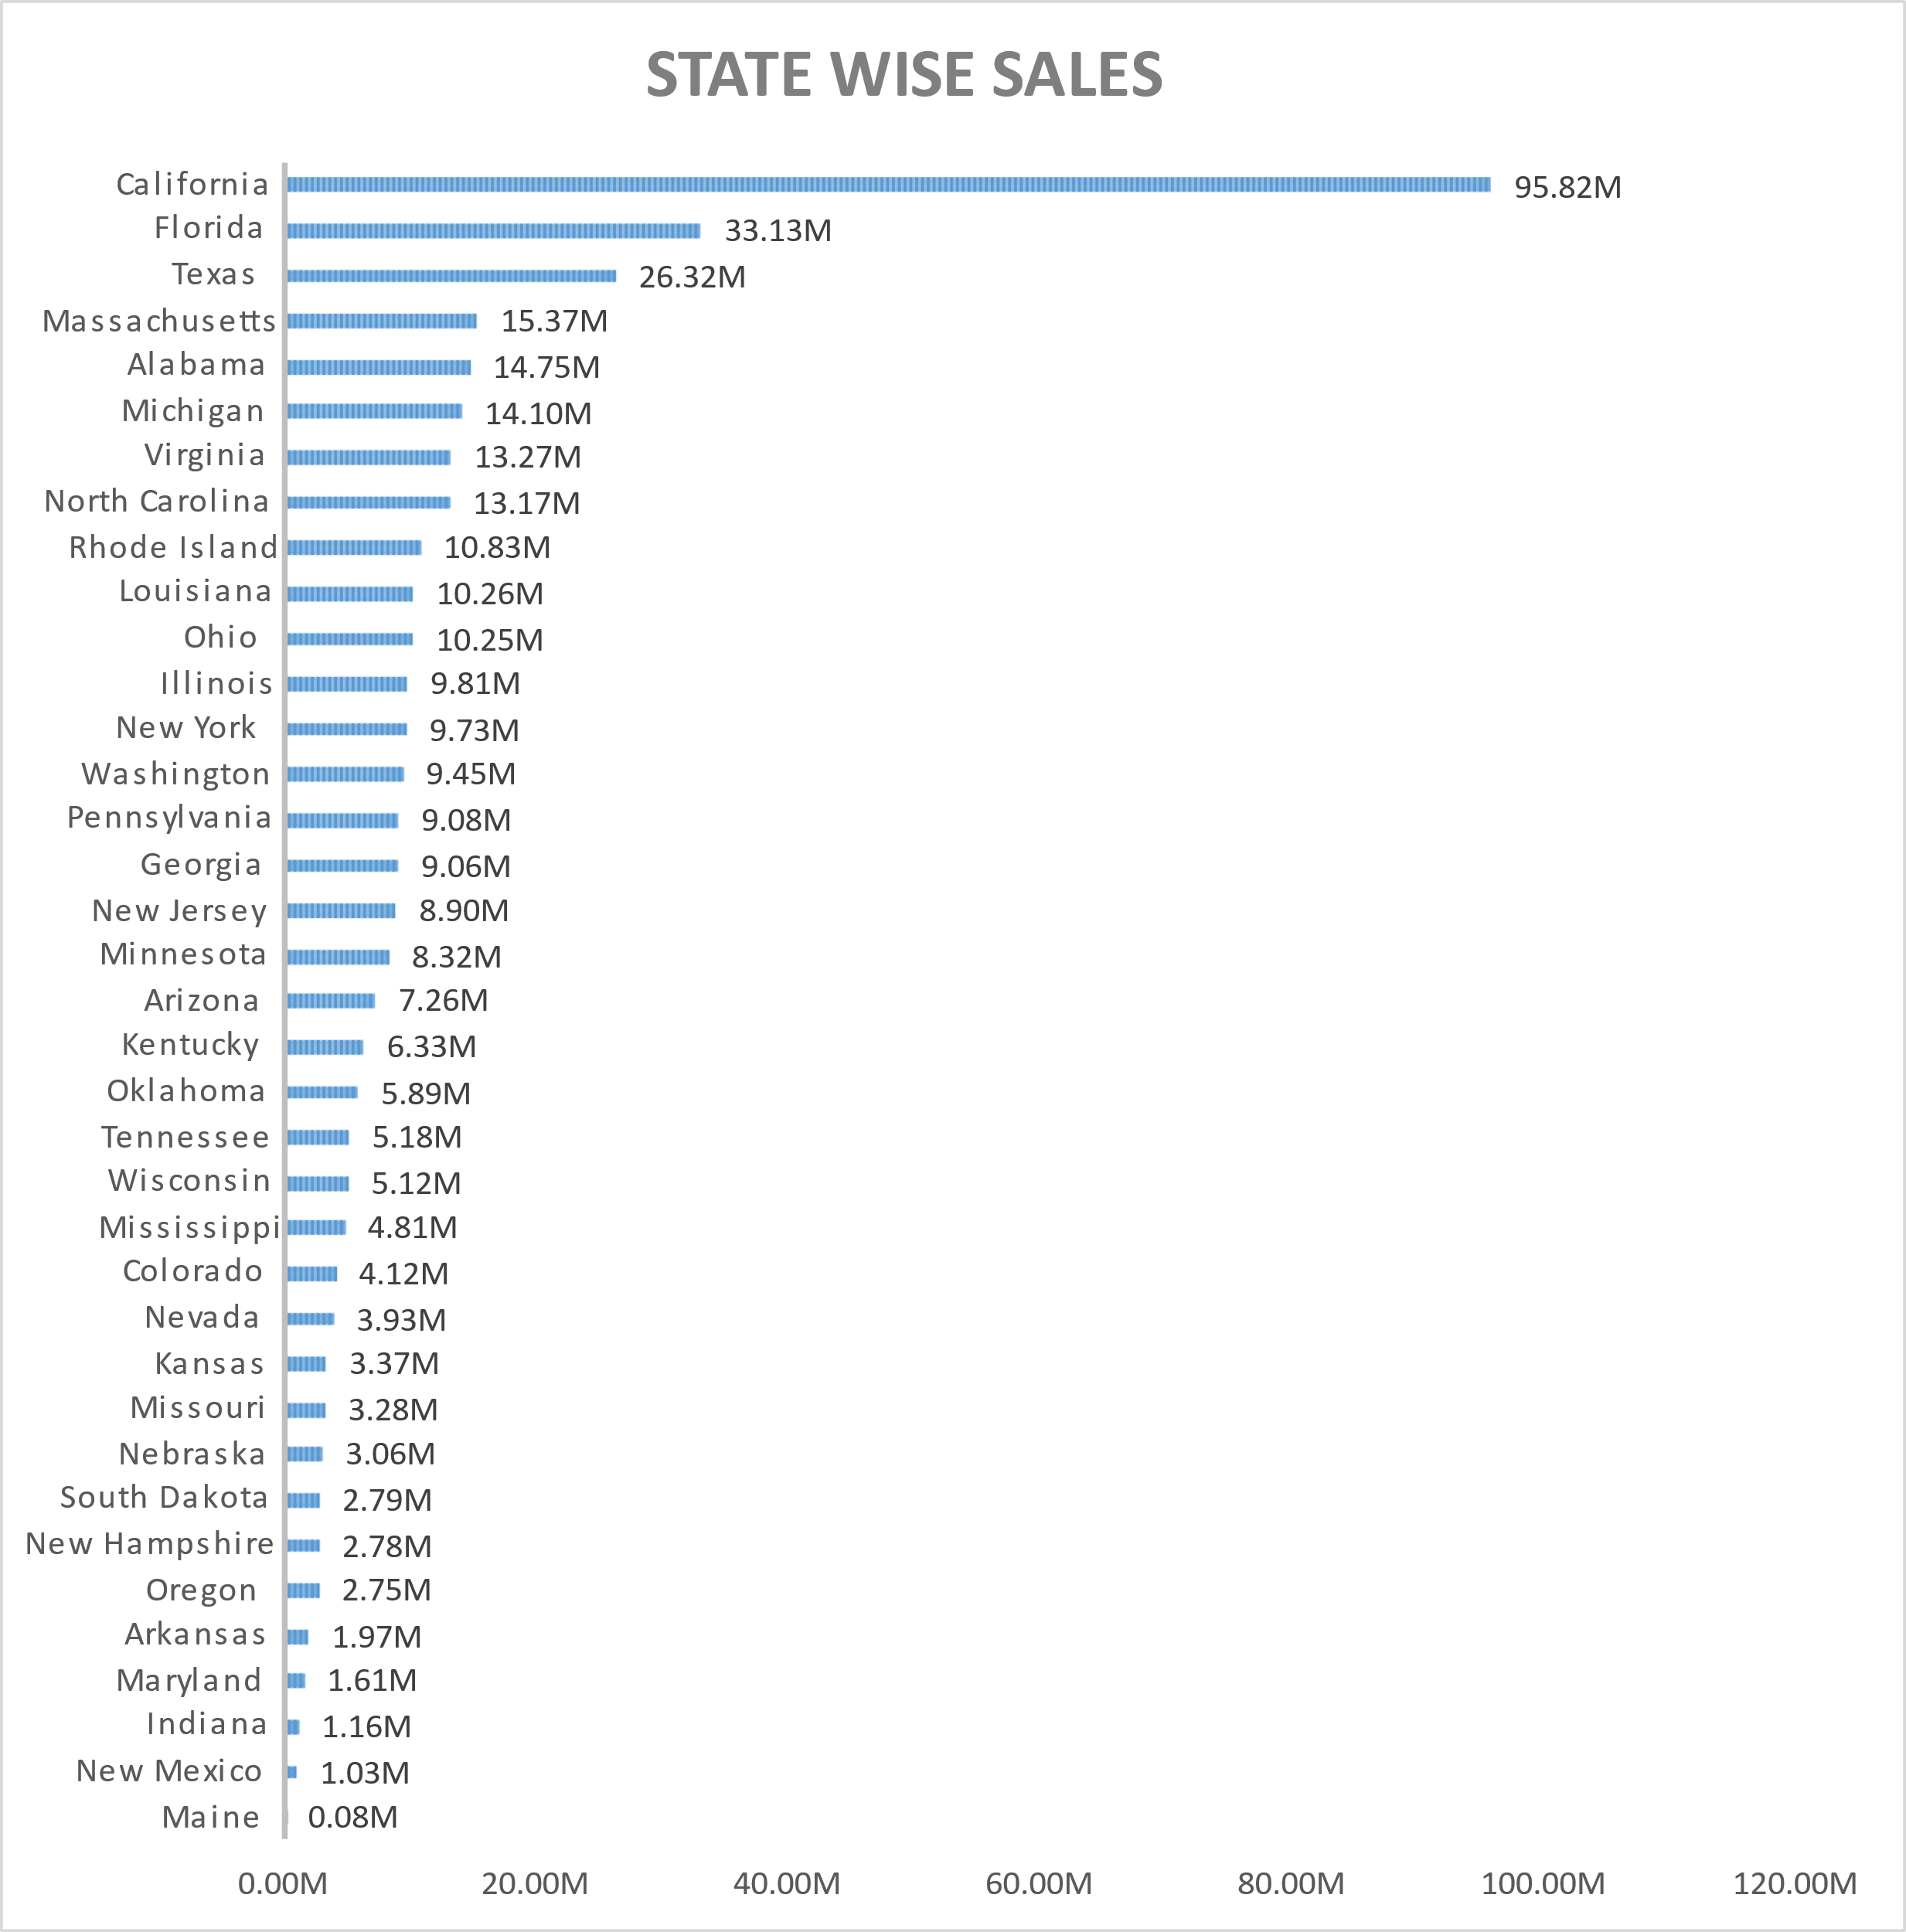
STATe WISe SALes
The Chart represents the State Wise Sales.
We can observe that California has the highest sales amount with 95.82M followed by Florida with 33.13M.
The Maine state has low sales amount with 0.08M.
Lowest sales are happening in maine so the company has to focus on maine by making some changes to increase the sales.

Slide 9
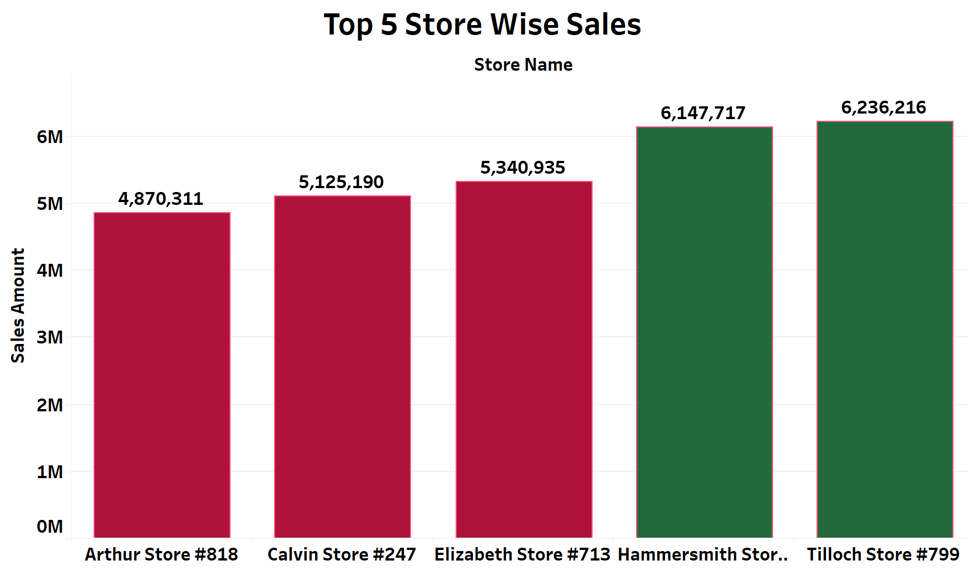
TOP 5 STORE WISE SALES
The Bar Chart Represent The Top 5 Store Wise Sales.
We Can Observe That The Tilloch store Is The Top 1 Store With 6,236,216 Sales Amount. Hammersmith Store Is The Top 2 Store With 6,147,717 Sales Amount.
Elizabeth Store Is The Top 3 Store With 5,340,935 Sales Amount.
Calvin Store Is The Top 4 Store With 5,125,190 Sales Amount.
Arthur Store Is The Top 5 Store With 4,870,311 Sales Amount.

Slide 10
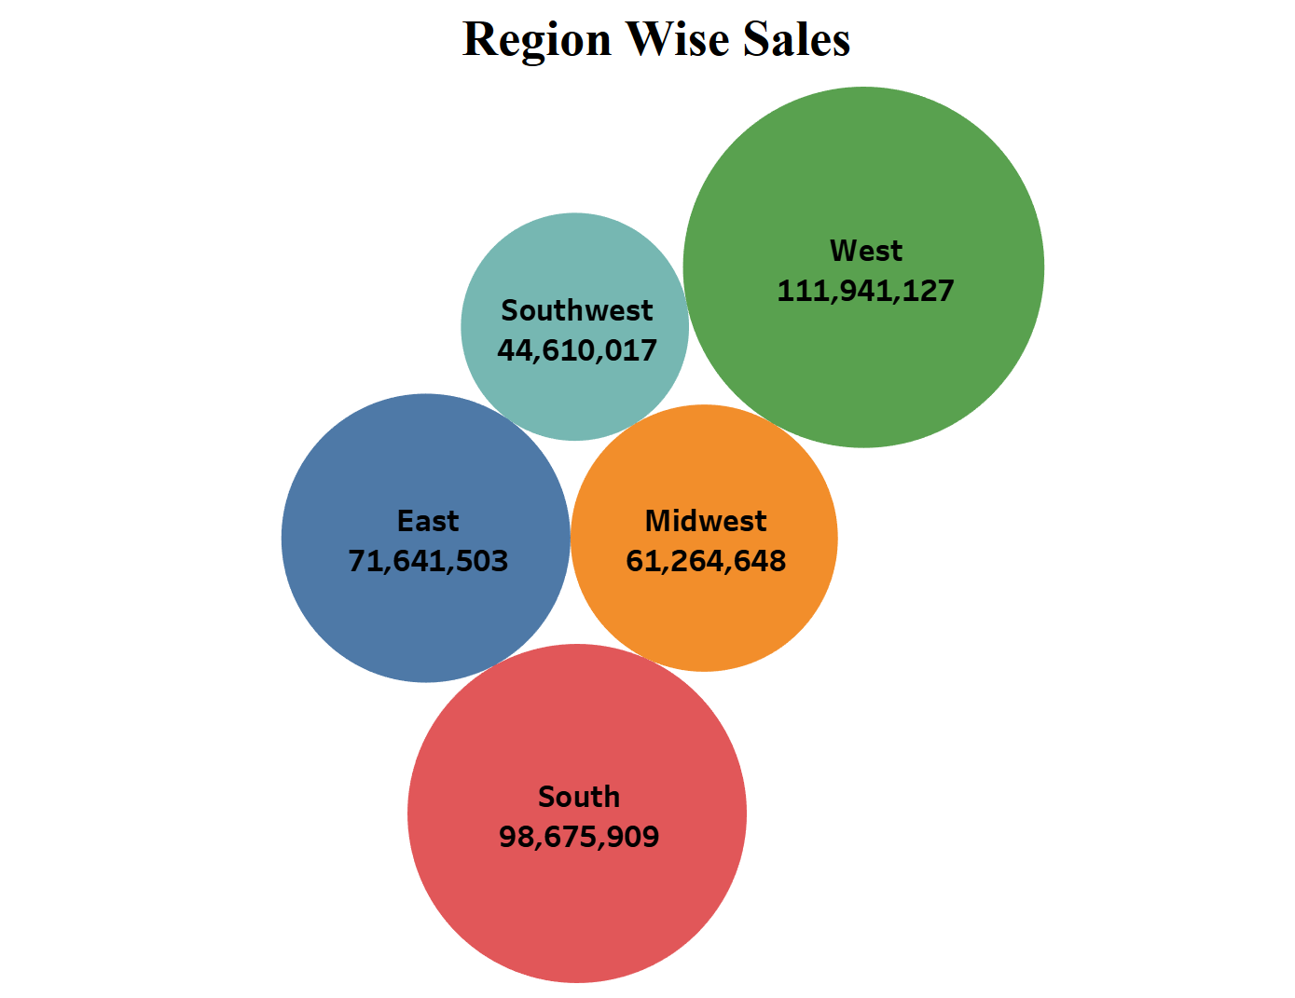
ReGION WISe SALeS
The chart gives the region wise sales. In this chart the diameter of the circle is directly proportional to the sales amount.
The green circle represents the west region. The west region has the highest sales with 111,941,127 sales amount.
The southwest region has the lowest sales with 44,610,017 sales amount.
May be the west region have the more population and the southwest have the
less population.

Slide 11
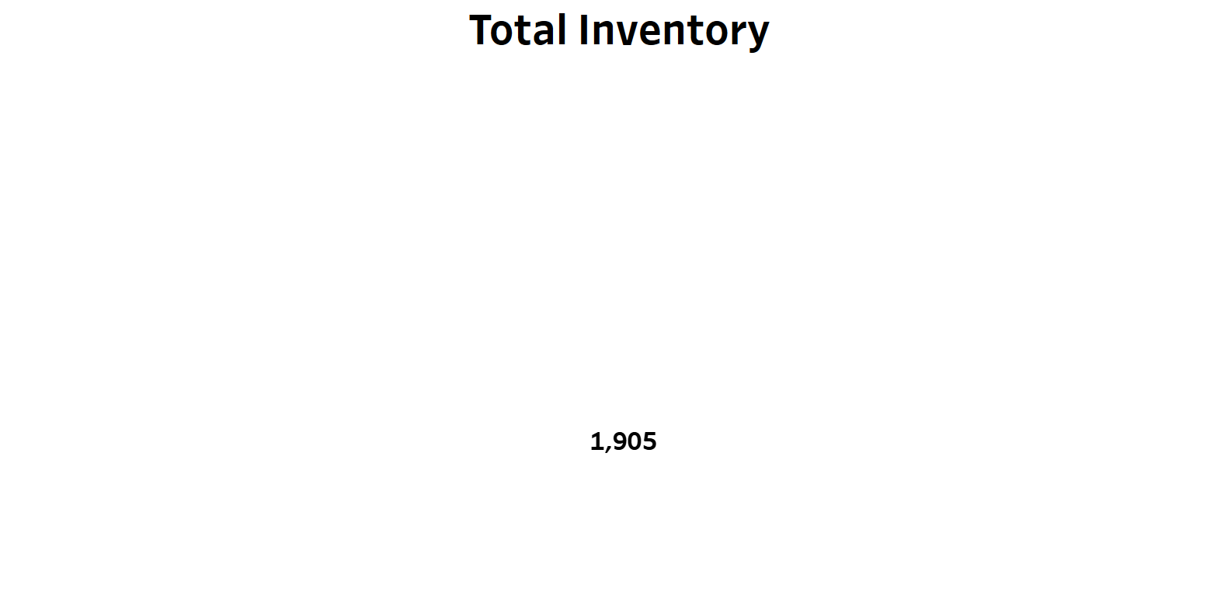
TOTAL INVeNTORY
Total inventory refers to the aggregate quantity of all goods, products, or materials that a business holds within its premises or at various locations. Calculating total inventory is a fundamental aspect of inventory management and is crucial for assessing the financial health of a business.
Here we took the sum of Quantity in hand as the Total Inventory. The Total Inventory is 1,905.

Slide 12
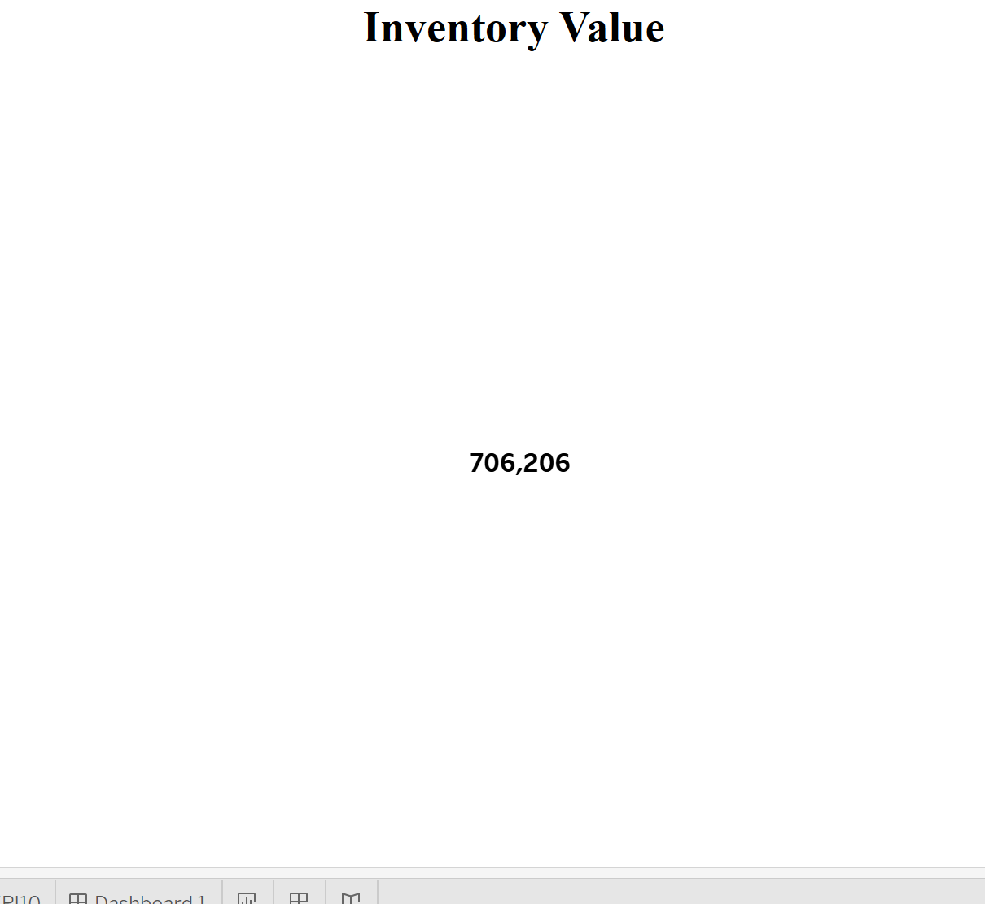
INVeNTORY VALUe
Inventory valuation is the cost associated with unsold inventory at the end of a reporting period. As we can see here the total Inventory Value is 7,06,206. It is calculated by multiplying the Quantity in hand with the Unit price of respective products.

Slide 13
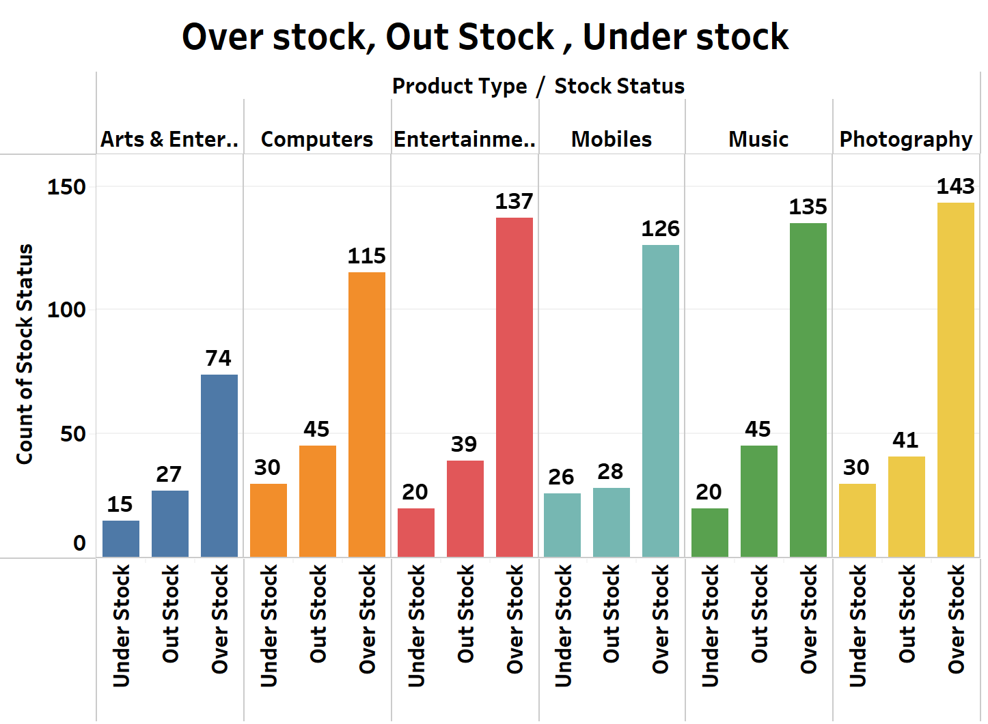
OVeR STOCK, OUT STOCK, UNDeR STOCK
This bar chart is dedicated to understanding the critical aspects of inventory management: overstock, out of stock, and understock situations.
These values are categorized by Product Type. As we look into the chart, we get the idea that most of the products in these categories are Over Stock. Out Stock and Under Stock are less compared to the Over Stock in the Inventory.
We suggest that the organization needs to focus on selling these Over Stock products by implementing crucial strategies and thus increase the sales growth in the future.
Balancing inventory levels is crucial for cost efficiency and customer satisfaction. Implementing strategies to maintain inventory level is essential for maintaining customer trust and maximizing sales opportunities.

Slide 14
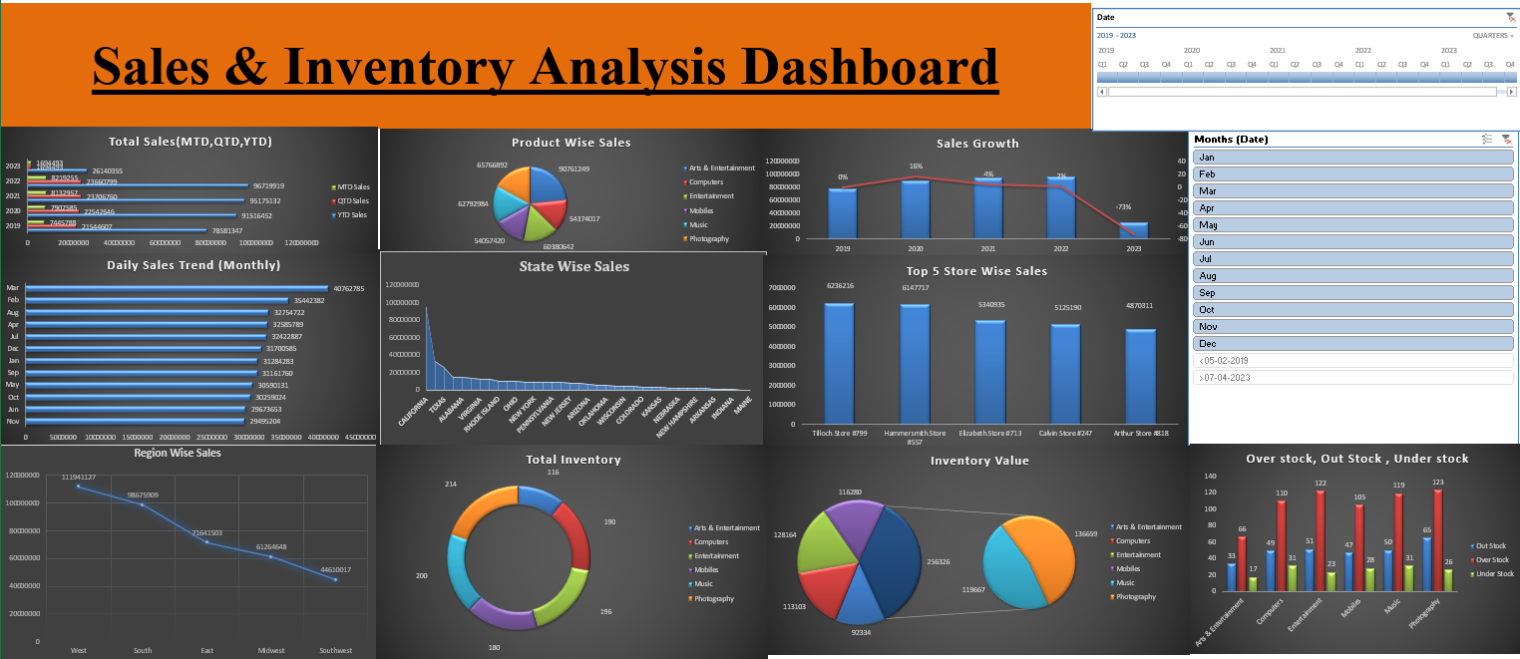
DASHBOARD

Slide 15
conclusion
To wrap it up, our inventory analysis journey has given us some important takeaways. By looking at sales numbers, product trends, and growth patterns, we've gotten a good grasp of how we're performing in the market. We've dived into daily sales, state-wise and store-wise data, giving us a clearer picture of where our strengths lie.
Zooming out, our exploration of regional sales has shown us how different areas impact our overall performance. On the inventory side, we've seen not just how much we have in stock but also how it affects our finances. Identifying overstock, out-of-stock, and understock situations is crucial for efficient operations.
As we move ahead, these insights should guide us in making smarter decisions about our inventory. It's not just about counting items; it's about using this information to be more agile, minimize risks, and make the most of opportunities.
We would like to thank our mentor Mr.Mahendra Singh sir for guiding us throughout the project. We would also like to thank ExcelR Solutions for giving us this opportunity to participate in this project.

Slide 16


Thank you

